Slide 1
VIRUS AND RELATED THREATS
© VSoft Technologies 2018

Slide 2
MALICIOUS PROGRAMS
NEED A HOST PROGRAM
EG-VIRUSES, BACKDOORS, LOGIC BOMBS
INDEPENDENT
EG-WORMS, ZOMBIE ETC

Slide 3
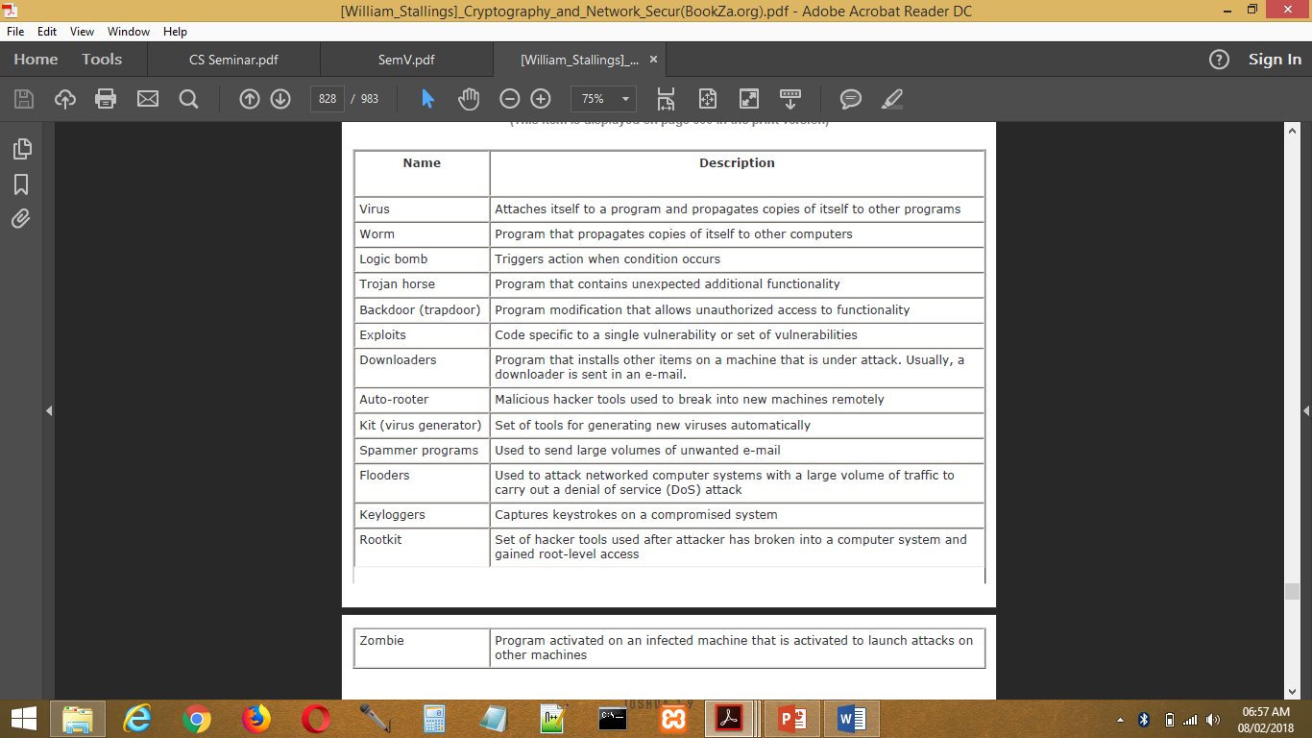
MALICIOUS PROGRAM TERMINOLOGIES

Slide 4
BACKDOOR
A backdoor, also known as a trapdoor, is a secret entry point into a program that allows someone that is aware of the backdoor to gain access without going through the usual security access procedures.
Programmers have used backdoors legitimately for many years to debug and test programs. This usually is done when the programmer is developing an application that has an authentication procedure, or a long setup, requiring the user to enter many different values to run the application.
The backdoor is code that recognizes some special sequence of input or is triggered by being run from a certain user ID or by an unlikely sequence of events.
Backdoors become threats when unscrupulous programmers use them to gain unauthorized access.
Security measures must focus on the program development and software update activities.

Slide 5
LOGIC BOMBS
One of the oldest types of program threat, predating viruses and worms, is the logic bomb.
The logic bomb is code embedded in some legitimate program that is set to "explode" when certain conditions are met.
Examples of conditions that can be used as triggers for a logic bomb are the presence or absence of certain files, a particular day of the week or date, or a particular user running the application.
Once triggered, a bomb may alter or delete data or entire files, cause a machine halt, or do some other damage.

Slide 6
TROJAN HORSE
A Trojan horse is a useful, or apparently useful, program or command procedure containing hidden code that, when invoked, performs some unwanted or harmful function.
Trojan horse programs can be used to accomplish functions indirectly that an unauthorized user could not accomplish directly.
For example, to gain access to the files of another user on a shared system, a user could create a Trojan horse program that, when executed, changed the invoking user's file permissions so that the files are readable by any user.
The author could then induce users to run the program by placing it in a common directory and naming it such that it appears to be a useful utility.

Slide 7
ZOMBIE
A zombie is a program that secretly takes over another Internet-attached computer and then uses that computer to launch attacks that are difficult to trace to the zombie's creator.
Zombies are used in denial-of-service attacks, typically against targeted Web sites.
The zombie is planted on hundreds of computers belonging to unsuspecting third parties, and then used to overwhelm the target Web site by launching an overwhelming onslaught of Internet traffic.

Slide 8
NATURE OF VIRUSES
A virus is a piece of software that can "infect" other programs by modifying them; the modification includes a copy of the virus program, which can then go on to infect other programs.

Slide 9
PHASES OF VIRUSES
Dormant phase: The virus is idle. The virus will eventually be activated by some event, such as a date, the presence of another program or file, or the capacity of the disk exceeding some limit. Not all viruses have this stage.
Propagation phase: The virus places an identical copy of itself into other programs or into certain system areas on the disk. Each infected program will now contain a clone of the virus, which will itself enter a propagation phase.
Triggering phase: The virus is activated to perform the function for which it was intended. As with the dormant phase, the triggering phase can be caused by a variety of system events, including a count of the number of times that this copy of the virus has made copies of itself.
Execution phase: The function is performed. The function may be harmless, such as a message on the screen, or damaging, such as the destruction of programs and data files.

Slide 10
VIRUS STRUCTURE
The key to its operation is that the infected program, when invoked, will first execute the virus code and then execute the original code of the program.

Slide 11
TYPES OF VIRUSES
Parasitic virus: The traditional and still most common form of virus. A parasitic virus attaches itself to executable files and replicates, when the infected program is executed, by finding other executable files to infect.
Memory-resident virus: Lodges in main memory as part of a resident system program. From that point on, the virus infects every program that executes.
Boot sector virus: Infects a master boot record or boot record and spreads when a system is booted from the disk containing the virus.
Stealth virus: A form of virus explicitly designed to hide itself from detection by antivirus software.

Slide 12
TYPES OF VIRUSES
Polymorphic virus: A virus that mutates with every infection, making detection by the "signature" of the virus impossible.
Metamorphic virus: As with a polymorphic virus, a metamorphic virus mutates with every infection. The difference is that a metamorphic virus rewrites itself completely at each iteration, increasing the difficulty of detection. Metamorphic viruses may change their behaviour as well as their appearance.

Slide 13
MACRO VIRUSES
A macro virus is platform independent. Virtually all of the macro viruses infect Microsoft Word documents. Any hardware platform and operating system that supports Word can be infected.
Macro viruses infect documents, not executable portions of code. Most of the information introduced onto a computer system is in the form of a document rather than a program.
Macro viruses are easily spread. A very common method is by electronic mail.

Slide 14
EMAIL VIRUSES
The e-mail virus sends itself to everyone on the mailing list in the user's e-mail package.
The virus does local damage.

Slide 15
WORMS
Worm is a program that can replicate itself and send copies from computer to computer across network connections.
Upon arrival, the worm may be activated to replicate and propagate again.
In addition to propagation, the worm usually performs some unwanted function.
To replicate itself, a network worm uses some sort of network vehicle. Examples include the following:
Electronic mail facility: A worm mails a copy of itself to other systems.
Remote execution capability: A worm executes a copy of itself on another system.
Remote login capability: A worm logs onto a remote system as a user and then uses commands to copy itself from one system to the other.

Slide 16
THE MORRIS WORM
The Morris worm was designed to spread on UNIX systems and used a number of different techniques for propagation.
For each discovered host, the worm tried a number of methods for gaining access:
It attempted to log on to a remote host as a legitimate user. In this method, the worm first attempted to crack the local password file, and then used the discovered passwords and corresponding user IDs. The assumption was that many users would use the same password on different systems.
To obtain the passwords, the worm ran a password-cracking program that tried, each user's account name and simple permutations of it.
A list of 432 built-in passwords that Morris thought to be likely candidates.
All the words in the local system directory.

Slide 17
THE MORRIS WORM
It exploited a bug in the finger protocol, which reports the whereabouts of a remote user.
It exploited a trapdoor in the debug option of the remote process that receives and sends mail.
If any of these attacks succeeded, the worm achieved communication with the operating system command interpreter.

Slide 18
STATE OF WORM TECHNOLOGY
Multiplatform: Newer worms are not limited to Windows machines but can attack a variety of platforms, especially the popular varieties of UNIX.
Multi-exploit: New worms penetrate systems in a variety of ways, using exploits against Web servers, browsers, e-mail, file sharing, and other network-based applications.
Ultrafast spreading: One technique to accelerate the spread of a worm is to conduct a prior Internet scan to accumulate Internet addresses of vulnerable machines.
Polymorphic: To evade detection, skip past filters, and foil real-time analysis, worms adopt the virus polymorphic technique. Each copy of the worm has new code generated on the fly using functionally equivalent instructions and encryption techniques.

Slide 19
STATE OF WORM TECHNOLOGY
Metamorphic: In addition to changing their appearance, metamorphic worms have a repertoire of behaviour patterns that are unleashed at different stages of propagation.
Transport vehicles: Because worms can rapidly compromise a large number of systems, they are ideal for spreading other distributed attack tools, such as distributed denial of service zombies.
Zero-day exploit: To achieve maximum surprise and distribution, a worm should exploit an unknown vulnerability that is only discovered by the general network community when the worm is launched.

